Slide 1
Core java
With MVC
Rohan Deshpande

Slide 2
// agenda
For convenience, the session today is divided into 3 parts
Quick quiz on Core Java
Create a small app based on the MVC that is the Model View Controller pattern using Core Java
If time permits, we can have a quick QnA round

Slide 3
// agenda
For convenience, the session today is divided into 3 parts
At the outset, we will have a quick overview of the vast topic that is Core Java in 30 min
In the second part, we will create a small app based on the MVC that is the Model View Controller pattern using core java
If time permits, we can have a quick QnA round

Slide 4
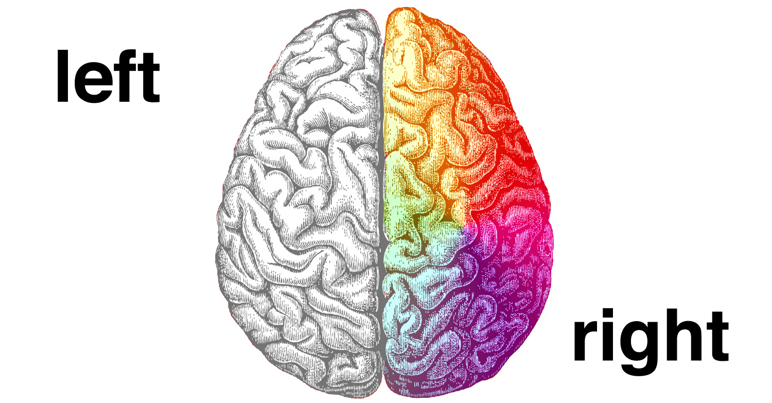
//A QUICK
brain
activity

Slide 5
JALDI 5 // fast 5

Slide 6
1. Can we have multiple classes in the same java file?
Yes
No

Slide 7
1. Can we have multiple classes in the same java file?
// Yes
No

Slide 8
2. What is polymorphism?
Is a technique to define different methods of the same type
Is the ability of an object to take on many forms
A method of hiding irrelevant data
Notes:
Is a technique to define different methods of the same type (function overloading)
Is the ability of an object to take on many forms (polymorphism)
A method of hiding irrelevant data

Slide 9
2. What is polymorphism?
Is a technique to define different methods of the same type
// Is the ability of an object to take on many forms
A method of hiding irrelevant data
Notes:
Is a technique to define different methods of the same type (function overloading)
Is the ability of an object to take on many forms (polymorphism)
A method of hiding irrelevant data

Slide 10
3. Which of the following is not a keyword in core java?
int
float
Boolean
char
Notes:
Boolean is a wrapper class

Slide 11
3. Which of the following is not a keyword in core java?
int
float
// Boolean
char
Notes:
Boolean is a wrapper class

Slide 12
4. Explain what does the keyword static mean?
It can be used to refer the common property of all objects
Can be accessed only by its subclasses
Can be accessed only by the methods of the same class
Notes:
It can be used to refer the common property of all objects
Can be accessed only by its subclasses (protected)
Can be accessed only by the methods of the same class (private)

Slide 13
4. Explain what does the keyword static mean?
// It can be used to refer the common property of all objects
Can be accessed only by its subclasses
Can be accessed only by the methods of the same class
Notes:
It can be used to refer the common property of all objects
Can be accessed only by its subclasses (protected)
Can be accessed only by the methods of the same class (private)

Slide 14
5. What will happen if the static modifier is removed from the signature of the main () method?
Compilation error
No such method error
Program will compile and run without any output
Program will compile and run to show the required output
Notes:
No such method error

Slide 15
5. What will happen if the static modifier is removed from the signature of the main () method?
Compilation error
// No such method error
Program will compile and run without any output
Program will compile and run to show the required output
Notes:
No such method error

Slide 16
// CORE JAVA

Slide 17
// all java access modifiers
Access Modifier | within class | within package | outside package by subclass only | outside package
Private | Y | N | N | N
Default | Y | Y | N | N
Protected | Y | Y | Y | N
Public | Y | Y | Y | Y

Slide 18
// A
right
brain
activity

Slide 19
// APP Design with MVC & core java

Slide 20
MVC – Model View Controller
Model is Data View is Interface Controller is Co-ordinator

Slide 21
// QnA

